Slide 1
Definition of done for User Story
Produced Design/code for presumed functionality.
Peer Design/Code Review performed
Assumptions/Acceptance criteria of User Story met
Project builds without errors
Unit tests written and passing
Project deployed on the test environment identical to production platform
Tests on web service client/browsers/Jmeter/Selenium listed in the project assumptions passed
QA (Quality Assurance) session performed
Issues from QA session resolved
Refactoring completed/Updated
Any configuration or build changes documented
Documentation updated (if exists)

Slide 2
Definition of Done for Design Story/Task
High Level Design (HLD) completed– Translates business requirements into a complete architecture design decisions for all key components of the component/story/Epics
Detailed Design Document (DDD) completed– Describes the architecture of each of the key components.
Document added in confluence and sign off by the Lead engineer/Architect.
Mapping of the Requirement to Design.

Slide 3
Definition of done for Development Story/Task
Code/Configuration builds without warnings/errors using the Design Story (technical task)
Code/Configuration unit tested & test result share with Leads Base testing completed and meet functional/non functional acceptance Criteria. (technical task)
Build & Release Documentation created /updated (in Confluence)-As-built Documentation (ABD) – Provides step-by-step instructions to deployment key components.
Configuration stored in Github
Build pushed to Dev server & demoed.

Slide 4
Definition of done for POC Story/Task
Create alternate design solution options document
Share the POC approach
Build & demoed to the team.
Share the decision and capture it in the decision log.

Slide 5
Definition of done for QA Story/Task
Unit tests implemented for new functionality(from requirement/user story/Design) and are all green (automated build and CI ensure this if possible).
Acceptance/story tests are written and passing.(test case stored in confluence)
Regression tests are green with known failures.(automated )
Enough exploratory testing has been done to ensure the correctness of new feature and to determine it works as expected
Unsolved defects are available in a defect backlog.
Traceability matrix creation and mapped

Slide 6
Definition of API build & UI development
Code produced (all 'to do' items in code completed)
Code commented, checked in and run against current version in GitHub
Peer reviewed (or produced with pair programming) and meeting development standards
Builds without errors
Unit tests written and passing
Deployed to Dev environment and passed system tests
Passed QA (User Acceptance Testing) and signed off as meeting requirements
Any build/deployment/configuration changes implemented/documented/communicated
Relevant documentation/diagrams produced and/or updated

Slide 7
Definition of done for QA Story/Task for UI/API Testing
Unit testing
100% unit test coverage with reviews
Cyclomatic code complexity and analysis of code using tools like SONAR
Defects in ‘acceptable’ state to the Product Owner
Unit tests code reviewed
All unit tests checked-in
All unit tests automated
Performance characteristics are within agreed limits
Integration testing
Code coverage is above x%. New implementation have not caused any regression or impact on code covergae (i.e code covergae has either preferably improved or remained static since last sprint).
Defects found reported and counted.
No major regression found
All regression tests are automated and checked in into github.
Acceptance criteria tested for both positive and negative tests based on agreed parameters
Quality risks identified and in acceptable
System testing
All stories in a release are tested en-to-end
All user persons covered, if applicable
Testing done in staging environment or Production like environment
Performance testing done
Quality risks covered and closed, if applicable.
Defects in “Acceptable” state to the Product Owner.
Regression tests are automated and checked-in
Release interfaces thoroughly checked.

Slide 8
Definition of Done for UAT Release
Release notes and other user notices
Internal and external communications
Finalization of end user documentation
Release packaging, bill of materials, configuration guides
Installation/deployment documentation
Training and documentation for support personnel
Quality management systems documentation (high assurance)
Approvals and signoffs

Slide 9
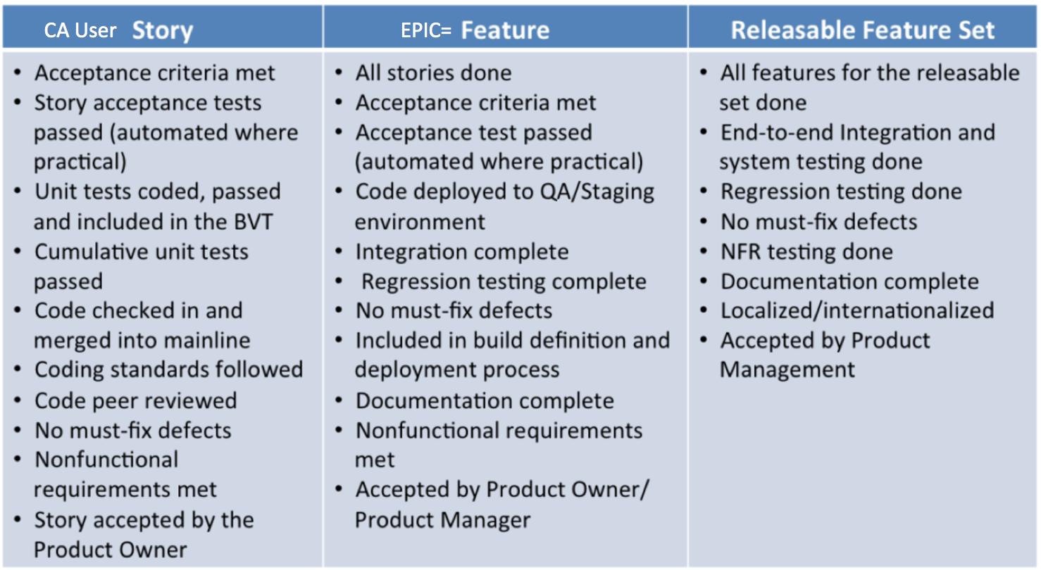
Definition of Done for ID2.0 Program( Story & Epic Level)

